Slide 1


Artificial Intelligence
Reporting Group: Group 4
Reporting Date：：2020-1-31

Slide 2
WHAT IS AI
any human-like intelligence
exhibited by a computer, robot, or other machine
the ability of a computer or machine to mimic the capabilities of the human mind
part of our everyday lives
Made by
the sudden availability of large amounts of data
the corresponding development
wide availability of computer systems that can process all that data faster and more accurately than humans can.

Slide 3


Slide 4




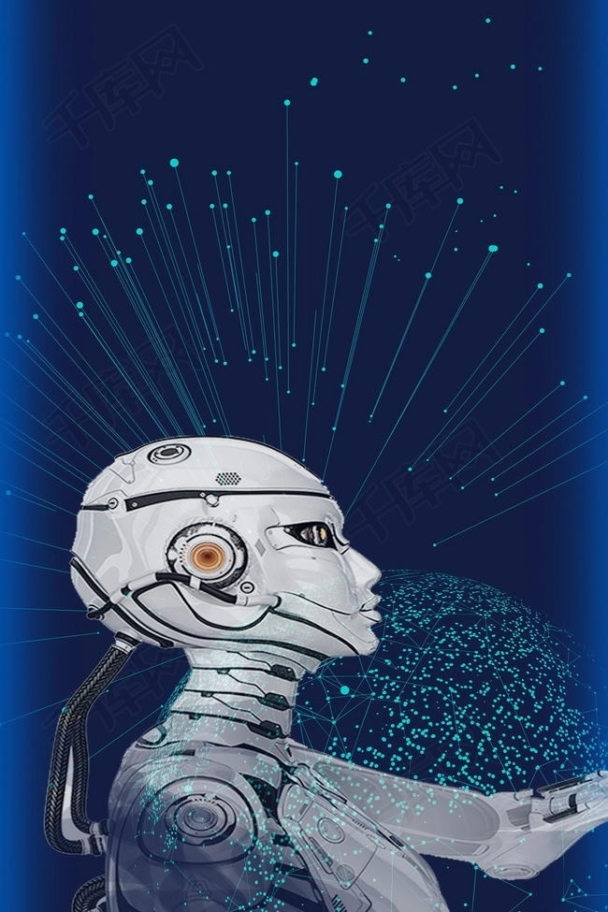
CONTENTS
CONTENTS
1
The origin of artificial intelligence
2
The development of artificial intelligence
3
The future of artificial intelligence

Slide 5

1
The origin

Slide 6
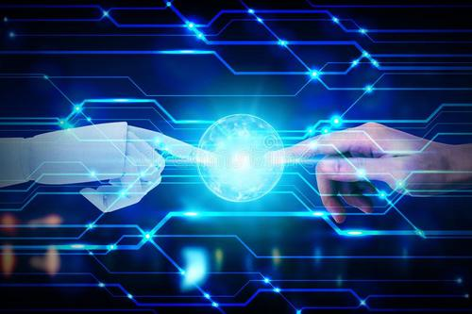
1.The germ of the idea of artificial intelligence:
In the 17th century,Pascal and Leibniz had an early idea of intelligent machines.
2.The beginning of artificial intelligence:
In the 19th century, British mathematicians Boer and de Morgan developed the "laws of thought".
Notes:
(1) the law of contradiction, (2) the law of excluded middle (or third), and (3) the principle of identity.

Slide 7
3.The precursor of artificial intelligence hardware:
In the 1820s, the British scientist Babbage designed the first “computing” machine.
4.First introduced as a discipline:
In 1956,artificial intelligence was first introduced as a discipline at a conference held at Dartmouth University.

Slide 8
2
The development of artificial intelligence

Slide 9
Time Line
01
02
03
04
Rethinking Development Period :
1960s to early 1970s
Application Period:
early 1970s to mid-1980s
The expert system appeared in 1970s
from the theory research to the practical application.
medical, chemical, geological and other fields
a new high tide of application development.
Dull Development:
mid-1980s to mid-1990s
the problems and shortcomings of expert system exposed
encountered bottlenecks.
Initial Development :
1956 to early 1960s
machine theorem proof checkers
set off the first climax of the development of artificial intelligence.
try more challenging tasks put forward some unrealistic R & D goals.
failures brought the development of artificial intelligence to a low point.

Slide 10
Electrical product design

Slide 11
Space Line
01
02
03
04
EU(European Union)：
The EU is launching a number of initiatives to promote open data sharing. On the one hand, it encourages wider sharing of privately owned data and provides legal and technical support for data sharing; on the other hand, it encourages the public sector to synchronize the opening of information and provide corresponding data acquisition and preservation advice to maximize data flow and sharing.
America：
The United States has obvious advantages in the development of artificial intelligence. Scientific research institutions have brought continuous innovation to artificial intelligence. Rapid iteration of relevant innovative products.
Silicon Valley is the key area of artificial intelligence development. In the scale of artificial intelligence financing, the United States dominates the world, accounting for more than 60 percent.
Germany：
The German government plays an important role in the primary stage of the development of industrial robots, leading the development of industrial robots to the direction of intelligence, lightweight, flexibility and high energy efficiency. Germany focuses on service robots to speed up the development and application of intelligent robots. Germany is in the forefront of the world in sensor, vehicle intelligent system and some other technical fields.
Chinese：
On July 20,2017, the Chinese government suddenly announced that, by 2030, it must seize the global commanding heights of artificial intelligence! By 2030, the theory, technology and application of artificial intelligence will reach the world's leading level and become the world's leading innovation center of artificial intelligence.

Slide 12
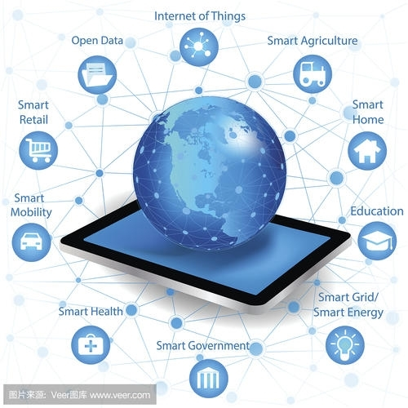
Current Situation
As the most promising technical field in the new era, artificial intelligence has been used and developed in many fields, such as man-machine war in go and Alpha Go. However, we have to admit that the development of artificial intelligence technology has not reached a very mature stage, and the artificial neural network simulated by computer can not be compared with the real brain. Although artificial intelligence has made good achievements in image recognition and many mature products have appeared in industry, artificial intelligence is limited by the defects of the model in natural language processing and can not really achieve perfect machine translation, pattern recognition and other applications.

Slide 13
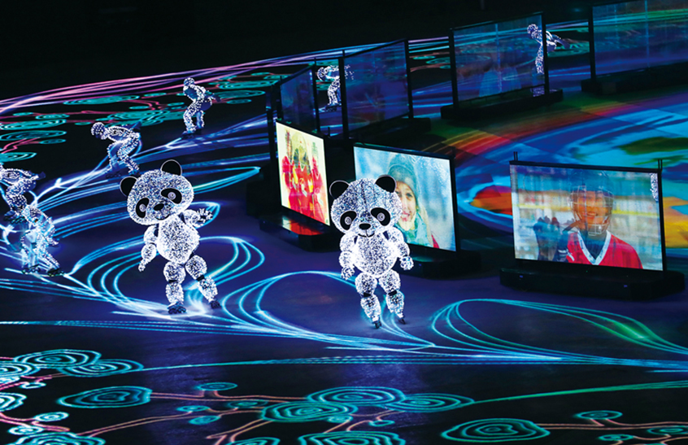
Application
February 25,2018, in Pyeongchang Winter Olympics closing ceremony "Beijing 8 minutes" performance, Smart mobile robots perform with roller skaters.

Slide 14

Application
On May 3,2018, the Chinese Academy of Sciences released the first cloud-based artificial intelligence chip in China, with a theoretical peak speed of 128 trillion fixed-point operations per second, reaching the world's advanced level.

Slide 15
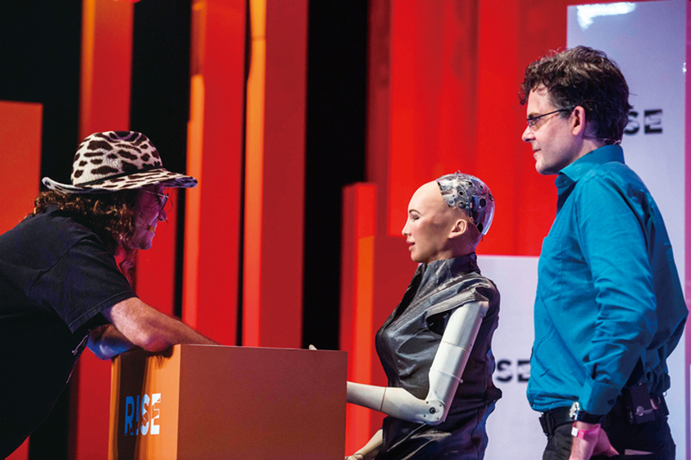
Application
In October 2017, at the future investment initiative conference in Riyadh, Saudi Arabia, robot Sophia was granted Saudi citizenship as the world's first robot to acquire citizenship.

Slide 16
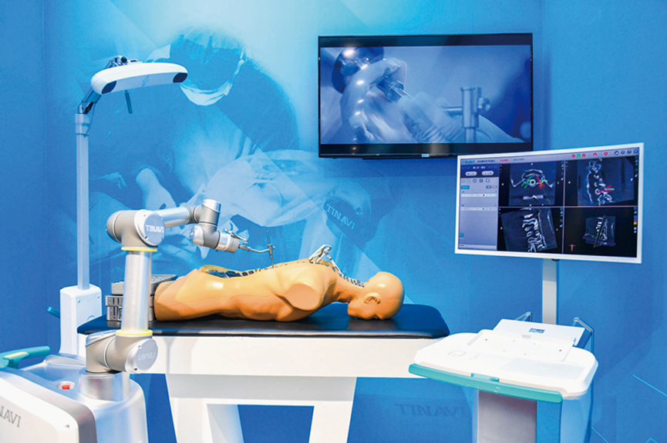
Application
November 22,2018, at the "Great changes —— Celebrating the 40th Anniversary of Reform Exhibition ", the third generation of domestic orthopedic surgery robot" Tianji "is having an operation.

Slide 17
3
The future of artificial intelligence

Slide 18
dedicated intelligence to universal intelligence.
artificial intelligence to human-machine hybrid intelligence.
"artificial and intelligent" to autonomous intelligent system development.
accelerate cross-penetration with other disciplines.
The artificial intelligence industry will flourish.
push humanity into a universal intelligent society. International competition in the field of artificial intelligence will become increasingly fierce.
The sociology of artificial intelligence will be on the agenda.

Slide 19
THANK YOU

